Slide 1
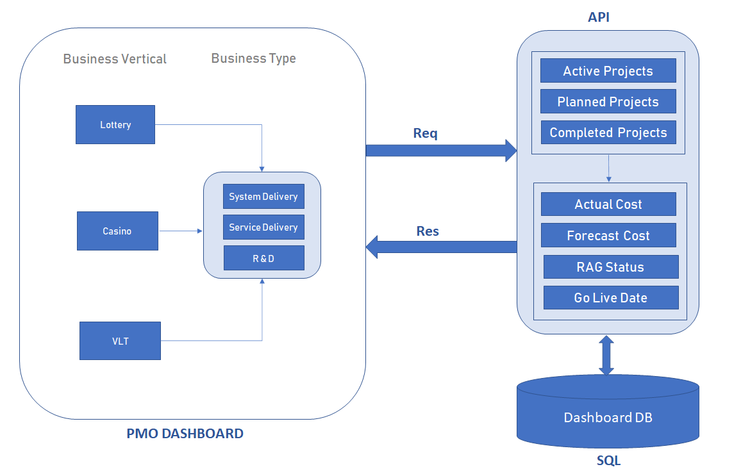
PMO Dashboard Solution Diagram

Slide 2
PMO Dashboard – Application Layers
UI Layer
Service Layer
Database Layer
Angular 8
eCHARTS – Chart Library
Material UI
RxJS, TypeScript, ES6
Consume REST API
JSON Data
MVC.NET with C#
Stored Procedure call
Exposed 2 APIs
Lottery
Casino & VLT
Result in JSON format
SQL server
Written Jobs to pull data from CTO DWH every day once.
3 tables used
Forecast
Project
Project Status
Written stored procedure to fetch data

